Slide 1
Bring Order to Your Photos: Event-Driven Classification of Flickr Images Based on Social Knowledge
Date: 2011/11/21
Source: Claudiu S. Firan (CIKM’10)
Speaker: Er-gang Liu
Advisor: Dr. Jia-ling Koh

Slide 2
Motivation
Image processing
Slow
fast
Tag

Slide 3
Outline
Introduction
Data Set
Event Detection
Evaluation Methodology
Experiment
Conclusion

Slide 4
Introduction
Motivation:
A huge amount of digital pictures remains untouched unless powerful techniques for image indexing and retrieval become available.
Goal:
To solve some of the users' knowledge management problems by providing the means to organize and browse content based on events.
Notes:
動機在用文字更精準定義 影像index和 retrieval 還沒有那麼強的技術
用event來組織整理 這些圖片。 可是這些event是透過user knowledge 所謂user的tag

Slide 5
Introduction
On the domain of pictures, in particular on a subset of Flickr data.
Using events as the primary means to organize pictures.
Construct classifiers for classifying pictures into different event categories.
Notes:
雙向關係. 用event方法來組織整理圖片. 也就是透過分類器 將圖片分類到各個event 類別

Slide 6
Event Definition
Defining an event as "specific thing happening”
specific time
specific place
EX：birthdays, marriages , vacations
Dimension
Local
EX：John’s birthday, 11/21 Lab KDD Group Meeting
Global
EX：2011 NBA lockout

Slide 7
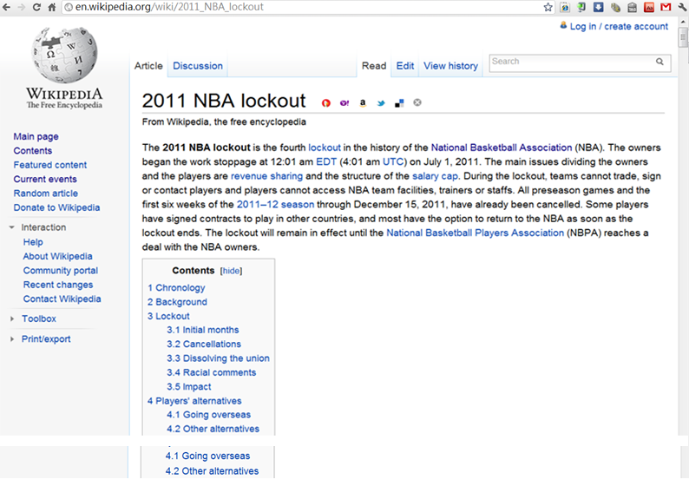

Slide 8
Data Set
Event Groups
Flickr Images
Wikipedia categories
WordNet concepts
Upcoming DataSet
Event ids
Notes:
用wiki 的Event page做為最小單位

Slide 9
Data Set
Event Group Wikipedia category WordNet concept
Notes:
大橢圓代表flickr圖片集合 小圓分別代表所屬的class
不同數量的類別種類

Slide 10
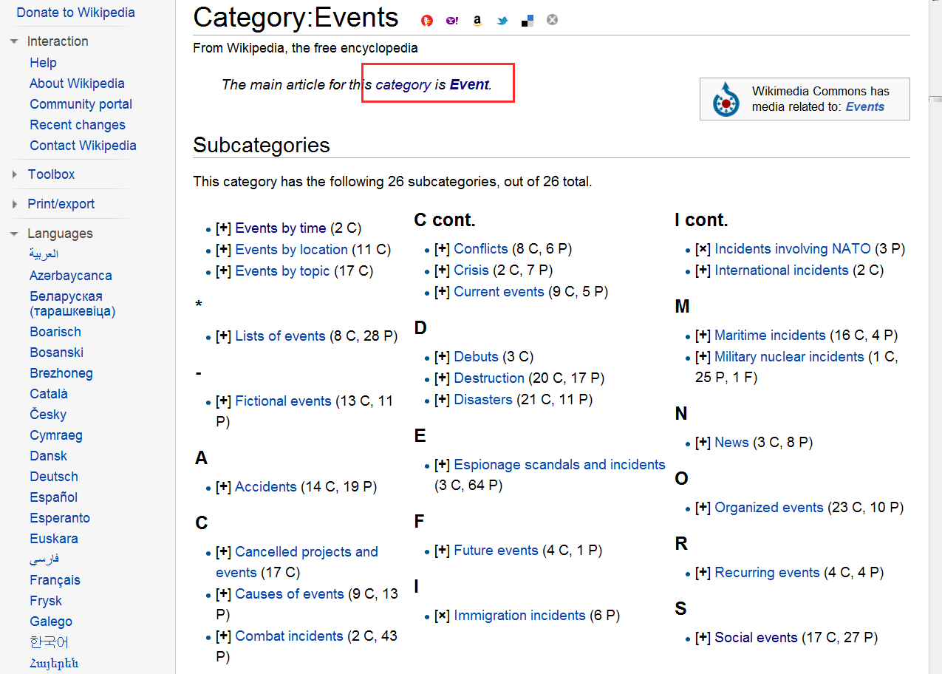

Slide 11
Data Set
Unclustered data set
Event Groups
hierarchical clustering
based on Wikipedia categories
based on WordNet concepts
Forming a three-level hierarchical taxonomy.
An extensive list of [events], along with the corresponding [categories] and the super-[concepts]

Slide 12
Event Detection From Tags
Try to assign the pictures to the corresponding event categories.
Photo event detection algorithm is a probabilistic classifier trained on the Flickr ground truth using tags as input features.
Using the Naive Bayes Multinomial implementation
textual { tags, title, description }
Based on time information -- SVM
time、 time + textual { tags, title, description }

Slide 13
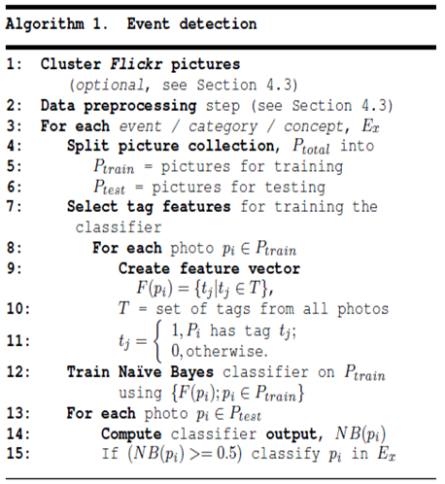
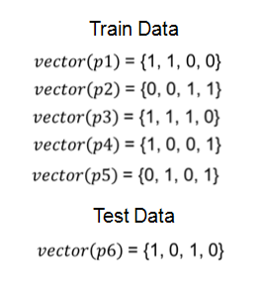
Event Detection Algorithm
Discard tags freq < 10
Discard photos tag
Discard class photo <100

Slide 14
Event Detection Algorithm
Train Data Class= Sports
 | t1 t2 t3 t4
ti=1 | YES | 2/3 2/3 2/3 1/3
ti=0 | YES | 1/3 1/3 1/3 2/3
ti=1 | No | 1/2 1/2 0 1
ti=0 | No | 1/2 1/2 1 0
$vector\left(p1\right)$ = {1, 1, 0, 0}
Yes
$vector\left(p2\right)$ = {0, 0, 1, 1}
Yes
$vector\left(p3\right)$ = {1, 1, 1, 0}
Yes
$vector\left(p4\right)$ = {1, 0, 0, 1}
No
$vector\left(p5\right)$ = {0, 1, 0, 1}
No
Test Data
$vector\left(p6\right)$ = {1, 0, 1, 0}
?
P(E | sports = yes) $∗$ P( sports = yes ) = ( $\frac{2}{3} ∗ \frac{1}{3}$ $∗ \frac{2}{3}$ $∗ \frac{2}{3})∗ \frac{3}{5} \text{=}$0.0593
P(E | sports = no) $∗\text{P}$( sports = no ) = ( $\frac{2}{3} ∗ \frac{1}{3}$ $∗0 ∗0$ )$∗ \frac{2}{5} \text{=}\text{ 0 }$

Slide 15
Evaluation Methodology
Evaluation methodology
Accuracy
Precision
Recall
NMI
B-Cubed

Slide 16
Evaluation
 | PREDICTED CLASS
ACTUAL CLASS |  | + | -
 | + | 150 | 40
 | - | 60 | 250
Notes:
Accuracy：是Class A 也分A 、不是A也沒分為A
Precision : 被分類為Class A中的picture 中,有多少真正是Class A.
Recall : 所有要被分為Class A 的picturet中,有多少有被分到.

Slide 17
Evaluation - B-Cubed
Notes:
將precision和recall求平均，這裡的平均是調和數(Harmonic)，

Slide 18
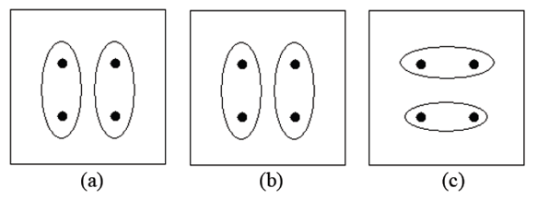
Evaluation – NMI
NMI = 1 NMI = 0
Notes:
(a)是理想分群結果，(b)與(a)相同，故NMI=1，(c)分群的結果明顯與(a)都不相同，故NMI=0

Slide 19
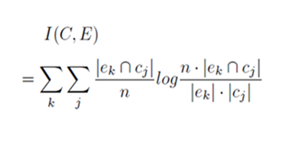
Evaluation – NMI
 | e1 | e2
c1 | 150 | 40
c2 | 60 | 250
I(C,E) = ( $\frac{150}{500}∗$log $\frac{500∗150}{210∗190}$ ) + ( $\frac{60}{500}∗$log $\frac{500∗60}{210∗310}$ )
+ ( $\frac{40}{500}∗$log$\frac{500∗40}{ 290∗190}$ ) + ( $\frac{250}{500}∗$log $\frac{500∗250}{290∗310}$ )
≈ ( 0.082 ) + ( -0.04 ) + ( -0.035 )+ ( 0.072 )
≈ 0.079

Slide 20
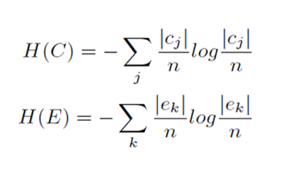
Evaluation – NMI
 | e1 | e2
c1 | 150 | 40
c2 | 60 | 250
H(C) = - ($\frac{190}{500}∗$ log$\frac{190}{500}$ ) - ($\frac{310}{500}∗$log$\frac{310}{500}$ ) ≈ - ( -0.160) - ( -0.129)
≈ 0.289
H(E) = - ( $\frac{210}{500}∗$log$\frac{210}{500}$ ) - ( $\frac{290}{500}∗$ log$\frac{290}{500 }$) ≈ - ( -0.158 ) - ( -0.137)
≈ 0.297

Slide 21
Evaluation – NMI

Slide 22
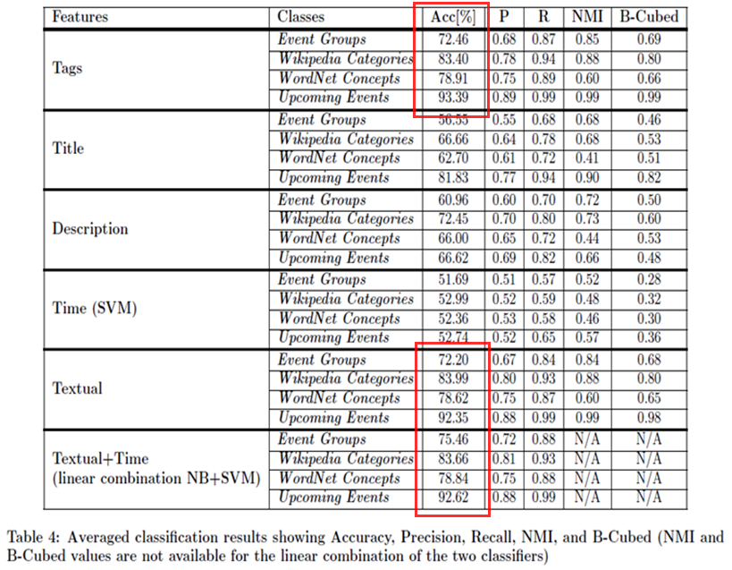
Experiment
Notes:
The reason for these results is the fact that the WordNet event categories represent more abstract event-related concepts.
The reason is given by the fact that here the ground truth is manually created by users

Slide 23
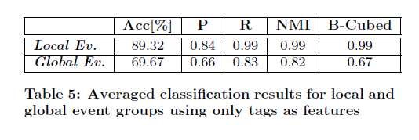
Local vs. Global Events

Slide 24
Conclusion
The approach is not restricted to this collection, but being applicable to any other photo set or other types of multimedia content (e.g. videos, music, etc.) containing similar metadata.
Show that photo event-based classification is feasible and confirm once more the quality of the user provided tags.
Notes:
證明event-driven的分類是可行的，並再次確認質量的用戶提供標籤

